Slide 1
Neuromorphic Vision
ISRC-CN³
²⁰²¹
^{Shane Harrigan}

Slide 2




Introduction
Neuromorphic Vision
Neuromorphic Data Processing
Questions

Slide 3
The Overlapping Fields
Neuroscience
Computer
Vision
Neuromorphic Vision
Bio-physics

Slide 4
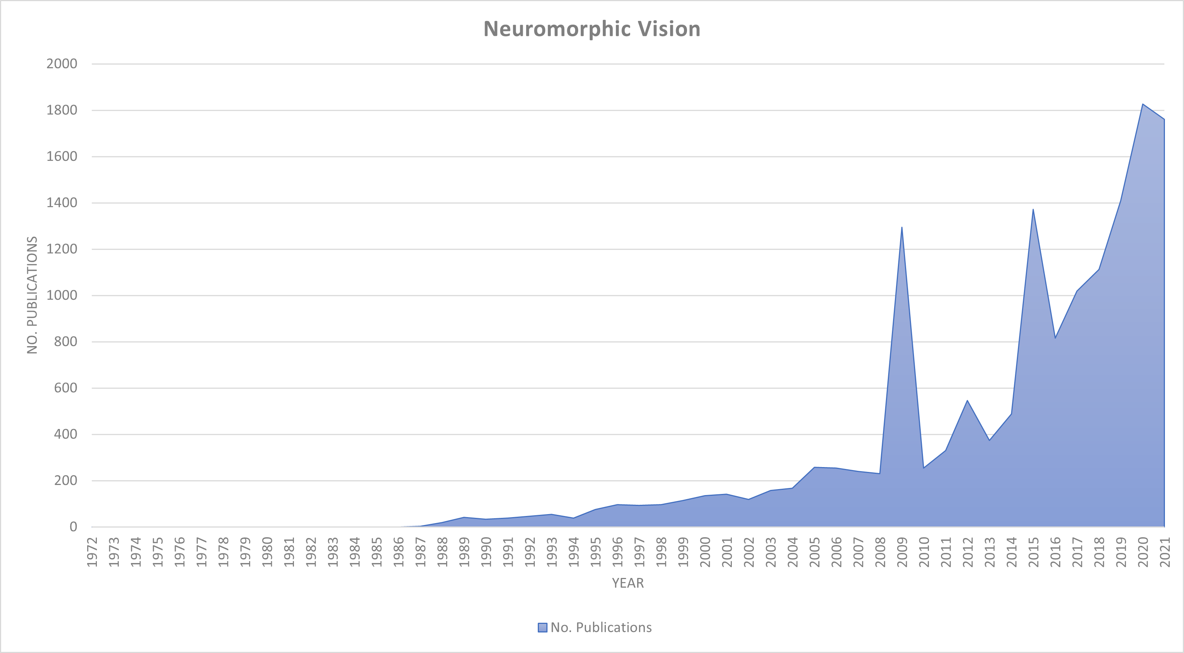
A Growing Topic
Ulster joins
Research efforts

Slide 5
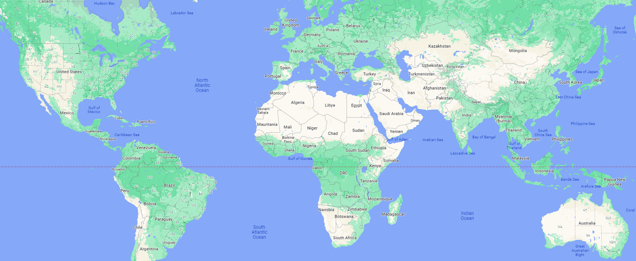

Research Community

Slide 6
The Photon
Photon
γ

Slide 7
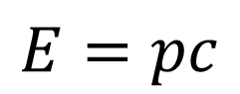
The Photon
Photon
γ
massless
$$E=pc$$
Energy momentum Speed-of-light

Slide 8
Artificial Phototransduction
Metal-oxide-based sensors
Binary
Image
γ
γ
γ

Slide 9
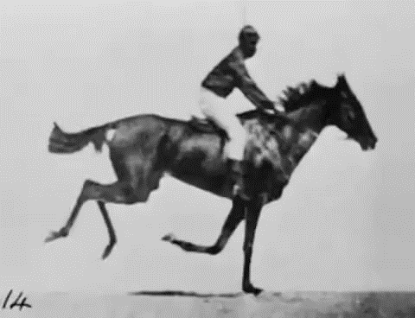
Muybridge (1878)

Slide 10
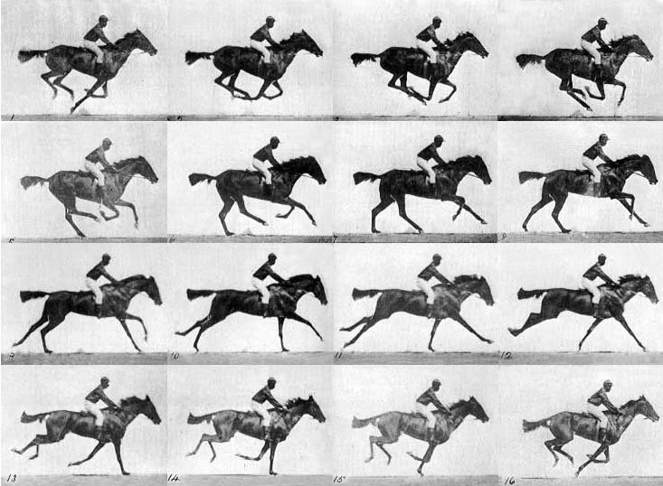

Slide 11
Synchronous Waste

Slide 12
Synchronous Error

Slide 13
Architecture Bottleneck
Power
# Frames
Performance

Slide 14
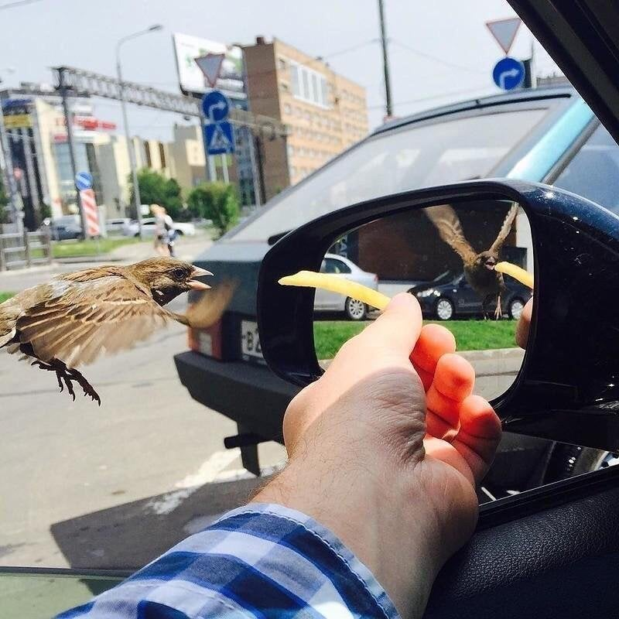
Rolling Shutter

Slide 15
Benefits of static vision sensors
Is the de facto language of machine vision.
Cheap
Has a solid ecosystem
Drawbacks of static vision sensors
Wasteful – in time, efficiency and power
Scene dynamics call for custom calibration of sampling

Slide 16
Introduction
Neuromorphic Vision
Neuromorphic Data Processing
Questions

Slide 17
The Eye

Slide 18
Phototransduction

Slide 19
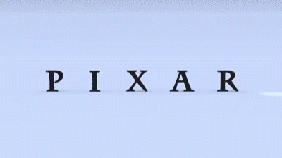
Phototransduction
© - Pixar

Slide 20
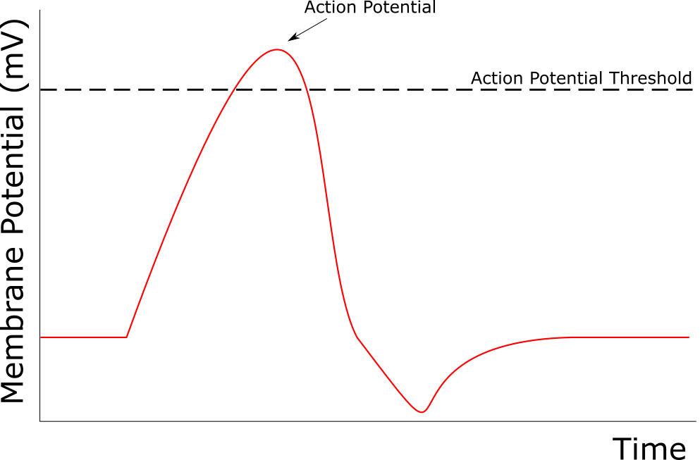
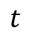
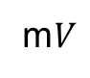
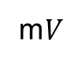
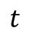
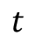
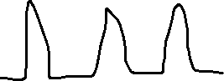
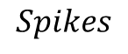
Signals
Spike
Threshold
m$V$
m$V$
$$t$$
$$t$$
$$Spikes$$
$$t$$

Slide 21
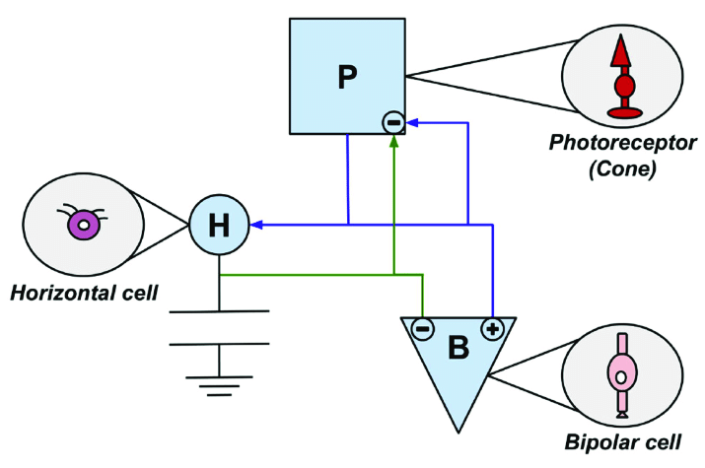
Silicon Retina

Slide 22
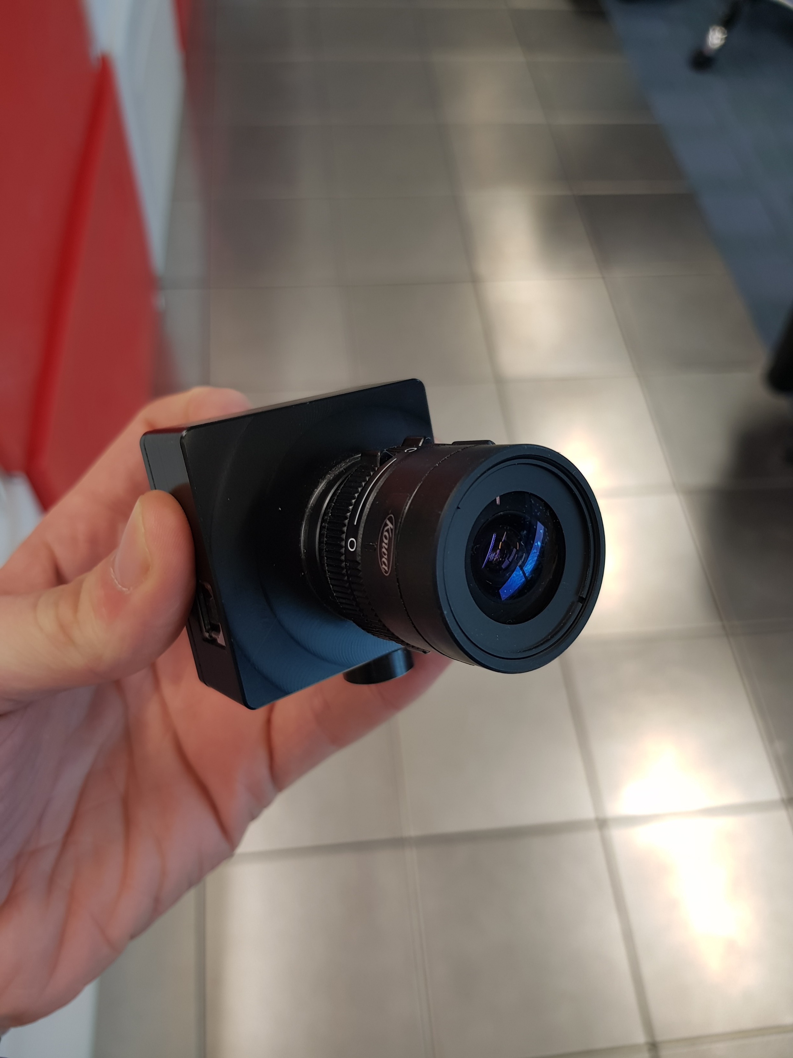
Dynamic Vision Sensor

Slide 23


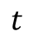
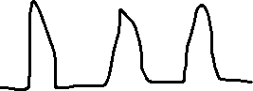
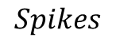
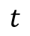
Neuromorphic Signals
$$Spikes$$
$$t$$
Spike AKA Event
$$1$$
$$0$$
$$t$$

Slide 24
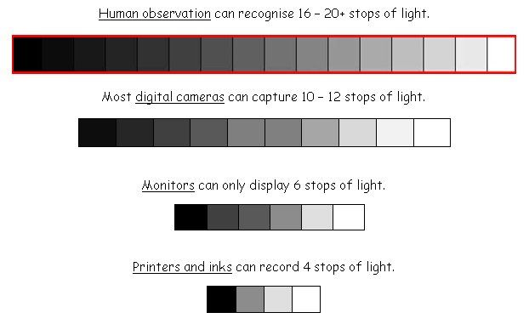
Dynamic Vision Sensor
Human Eye
Most DSLR Cameras
Computer Screens
Printers

Slide 25

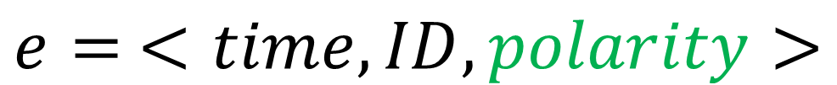
An Event
Asynchronous
At-pixel level signal
Indicates temporal change in light
$$e= <time,ID,polarity>$$

Slide 26
Polarity
+1
Light change
-1

Slide 27
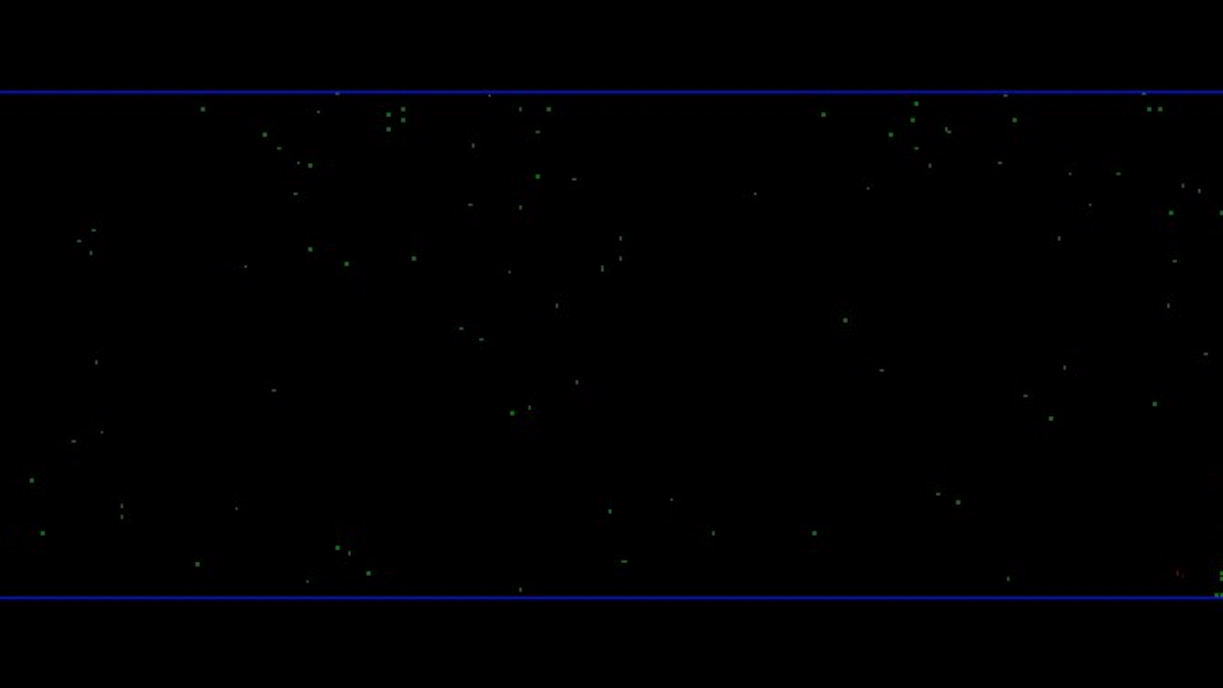
Example Output

Slide 28
Benefits of neuromorphic vision sensors
More energy efficient compared to conventional systems
Microsecond resolution as standard
Overcomes the power-to-efficiency bottleneck
Bio-inspired
Drawbacks of neuromorphic vision sensors
Too new!
Doesn’t sample large scene details

Slide 29
Introduction
Neuromorphic Vision
Neuromorphic Data Processing
Questions

Slide 30

Per-event Processing
Per-N-Packet Processing

Slide 31
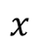
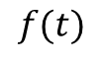
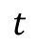
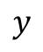
Event Transformation
Event Stream
Event-frame
$$y$$
$$f(t)$$
$$t$$
$$x$$

Slide 32
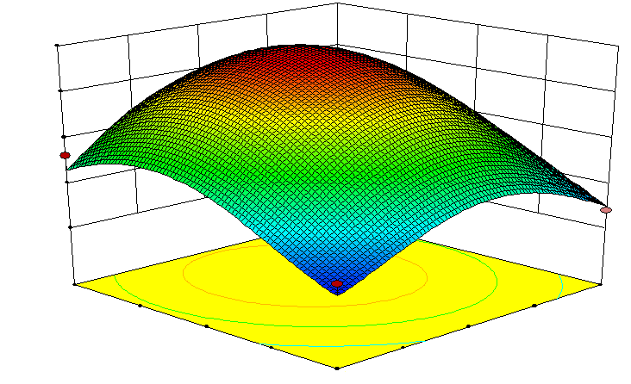
Event Transformation
Time Surface

Slide 33
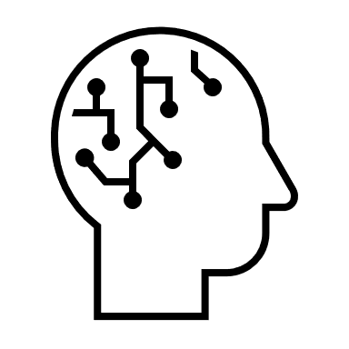
Machine Learning

Slide 34


Industrial Automation

Slide 35


Security

Slide 36






Autonomous Driving

Slide 37
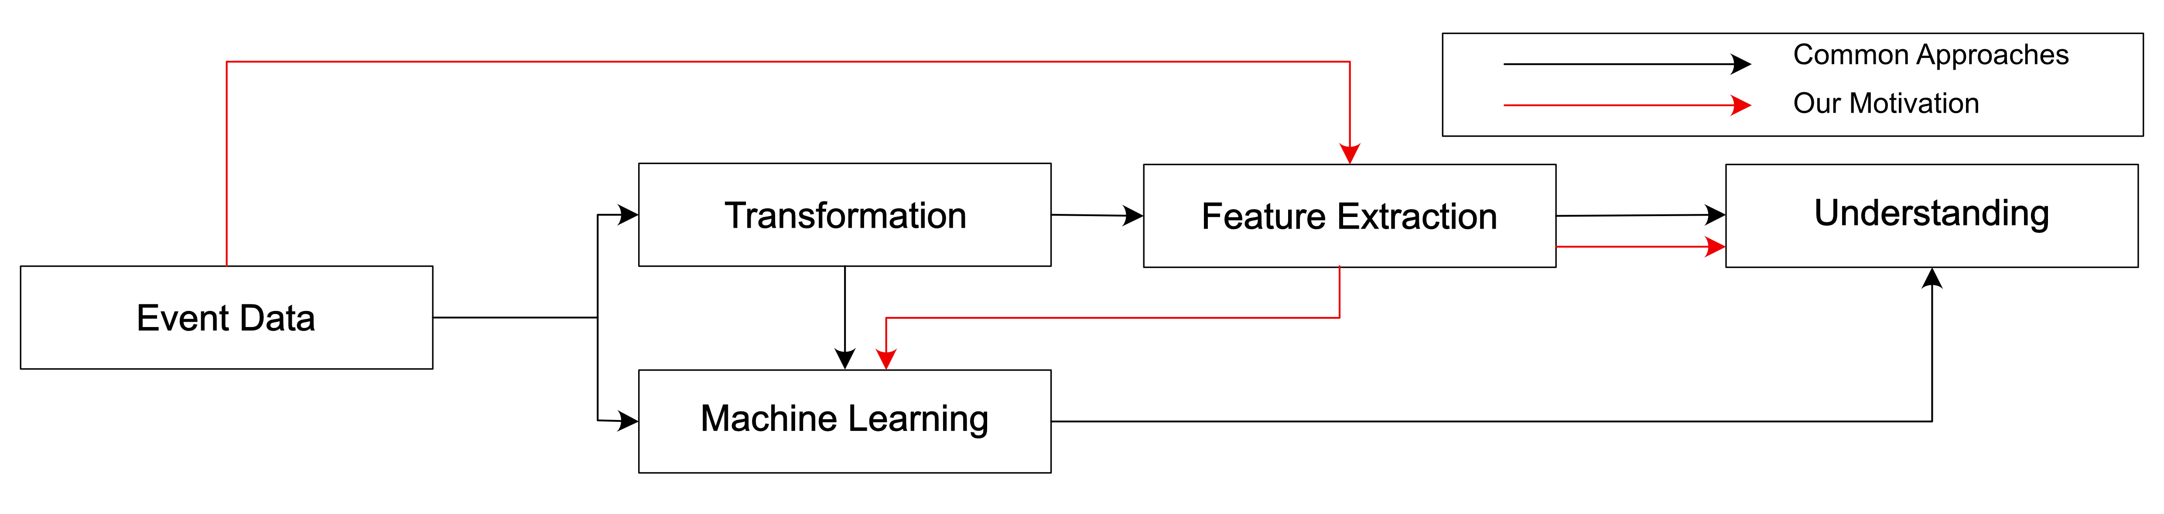
Our Research

Slide 38
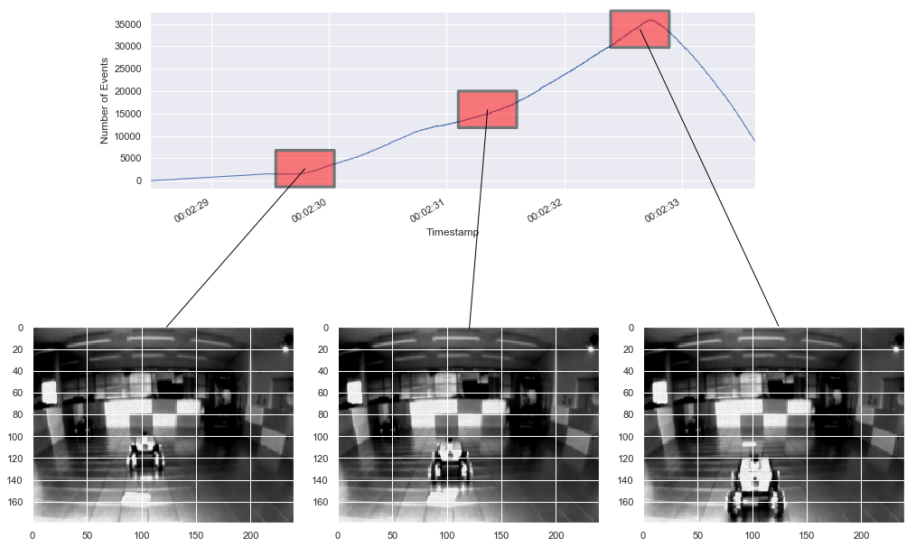
Our Research

Slide 39
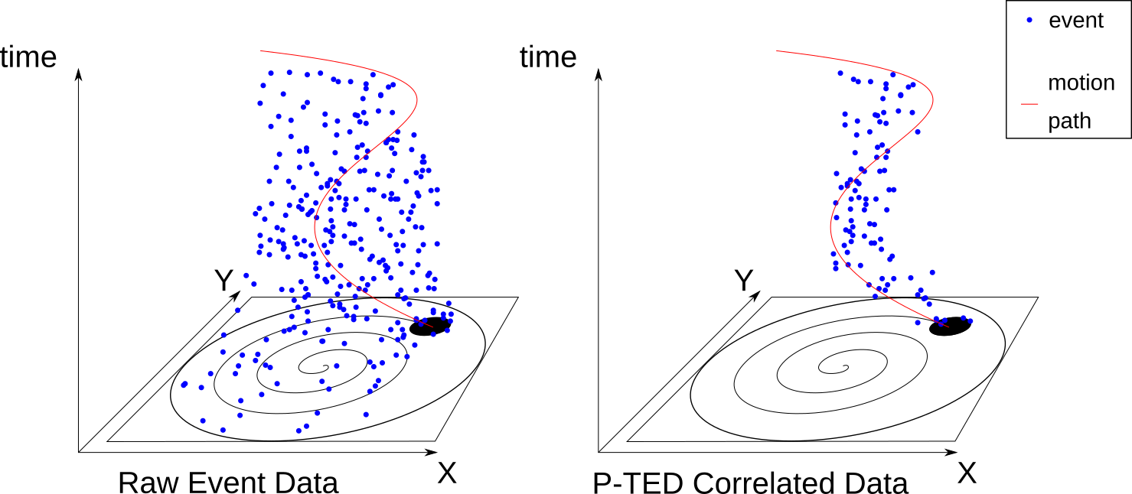
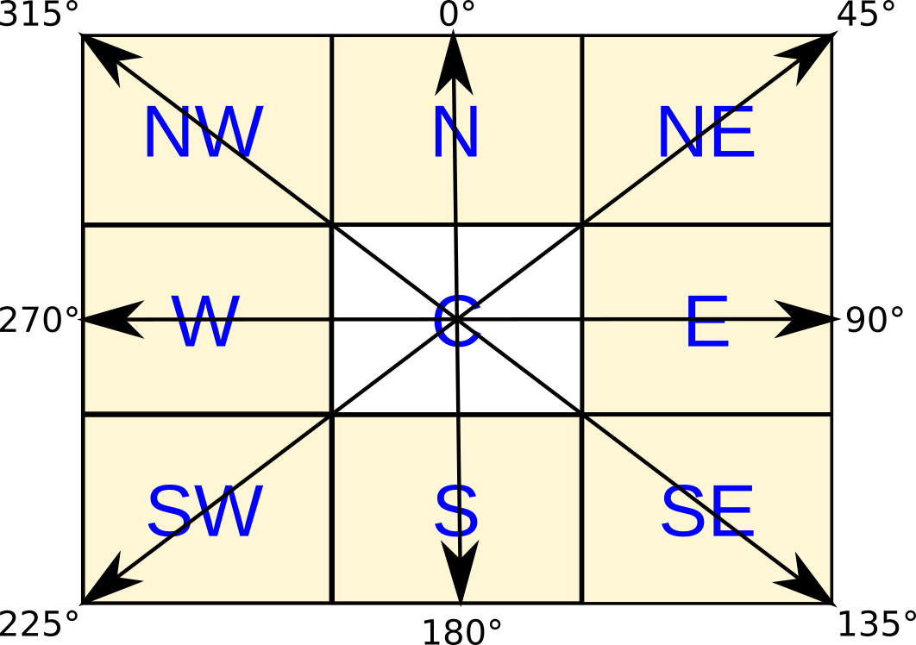
Our Research

Slide 40
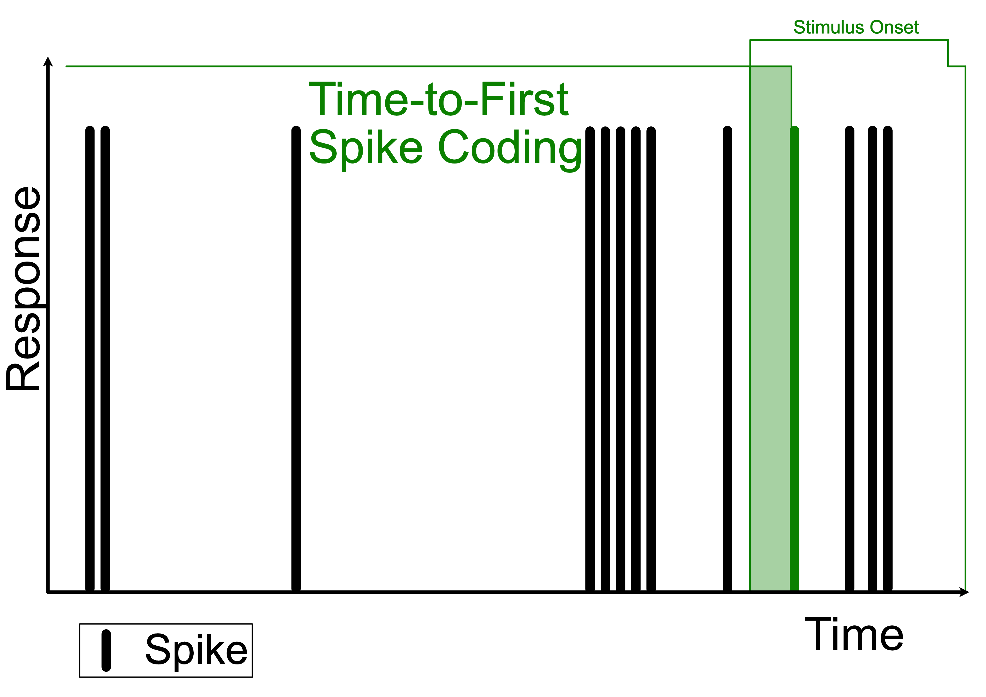
Our Research

Slide 41
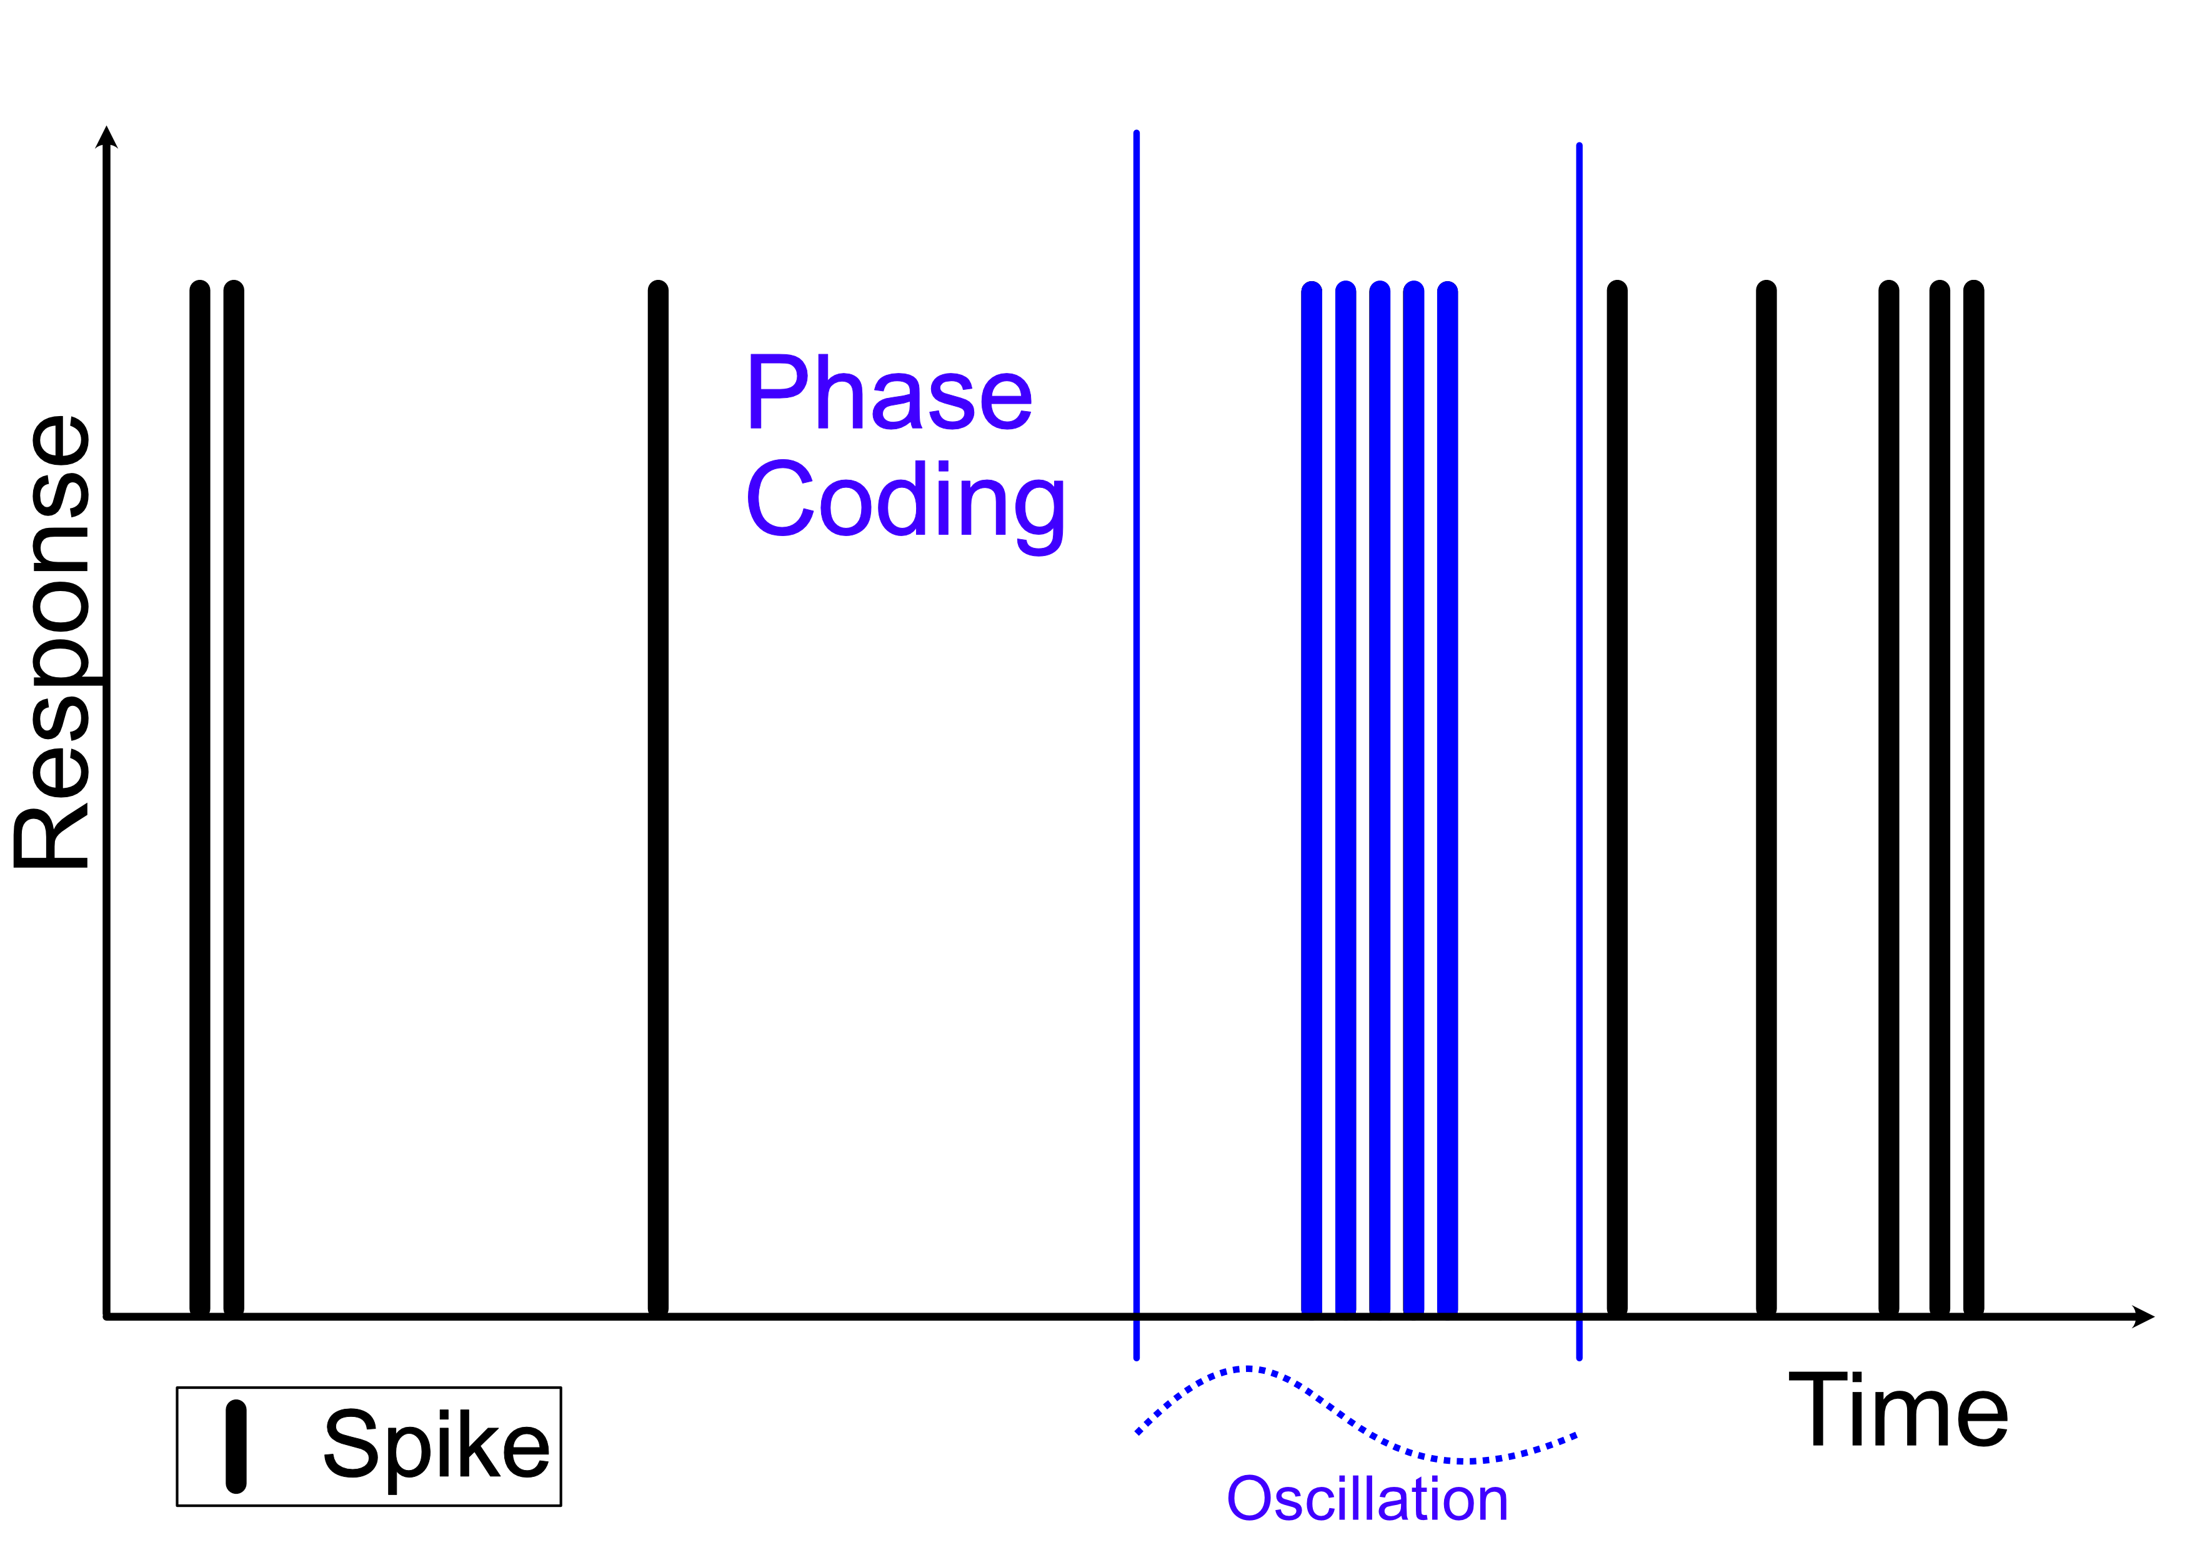
Our Research

Slide 42
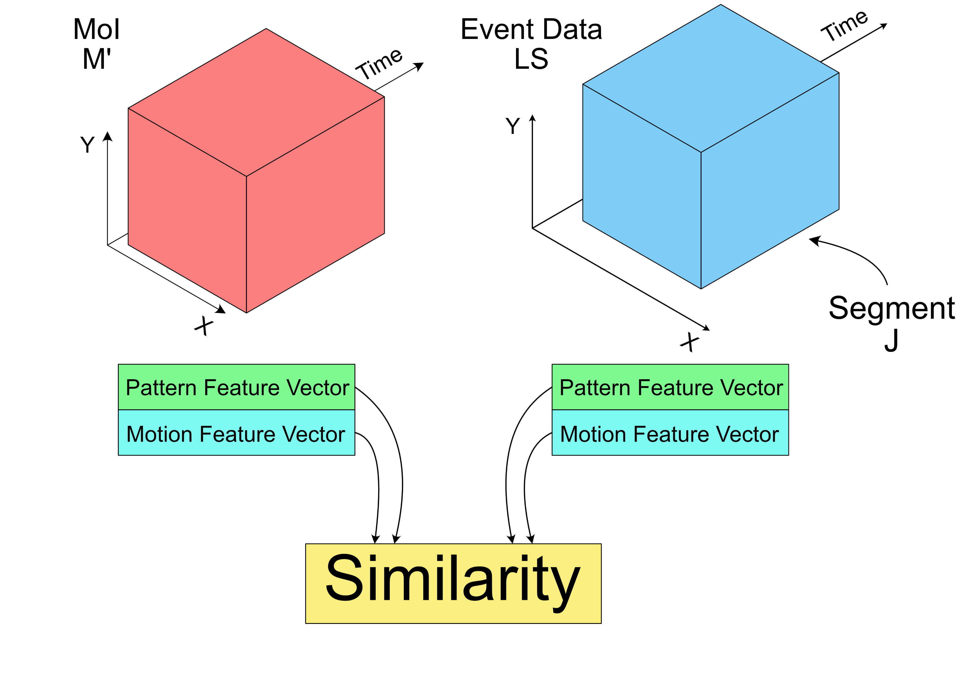
Our Research

Slide 43
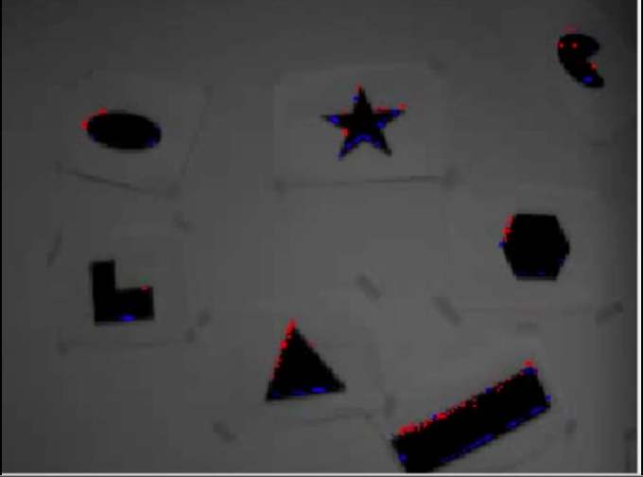
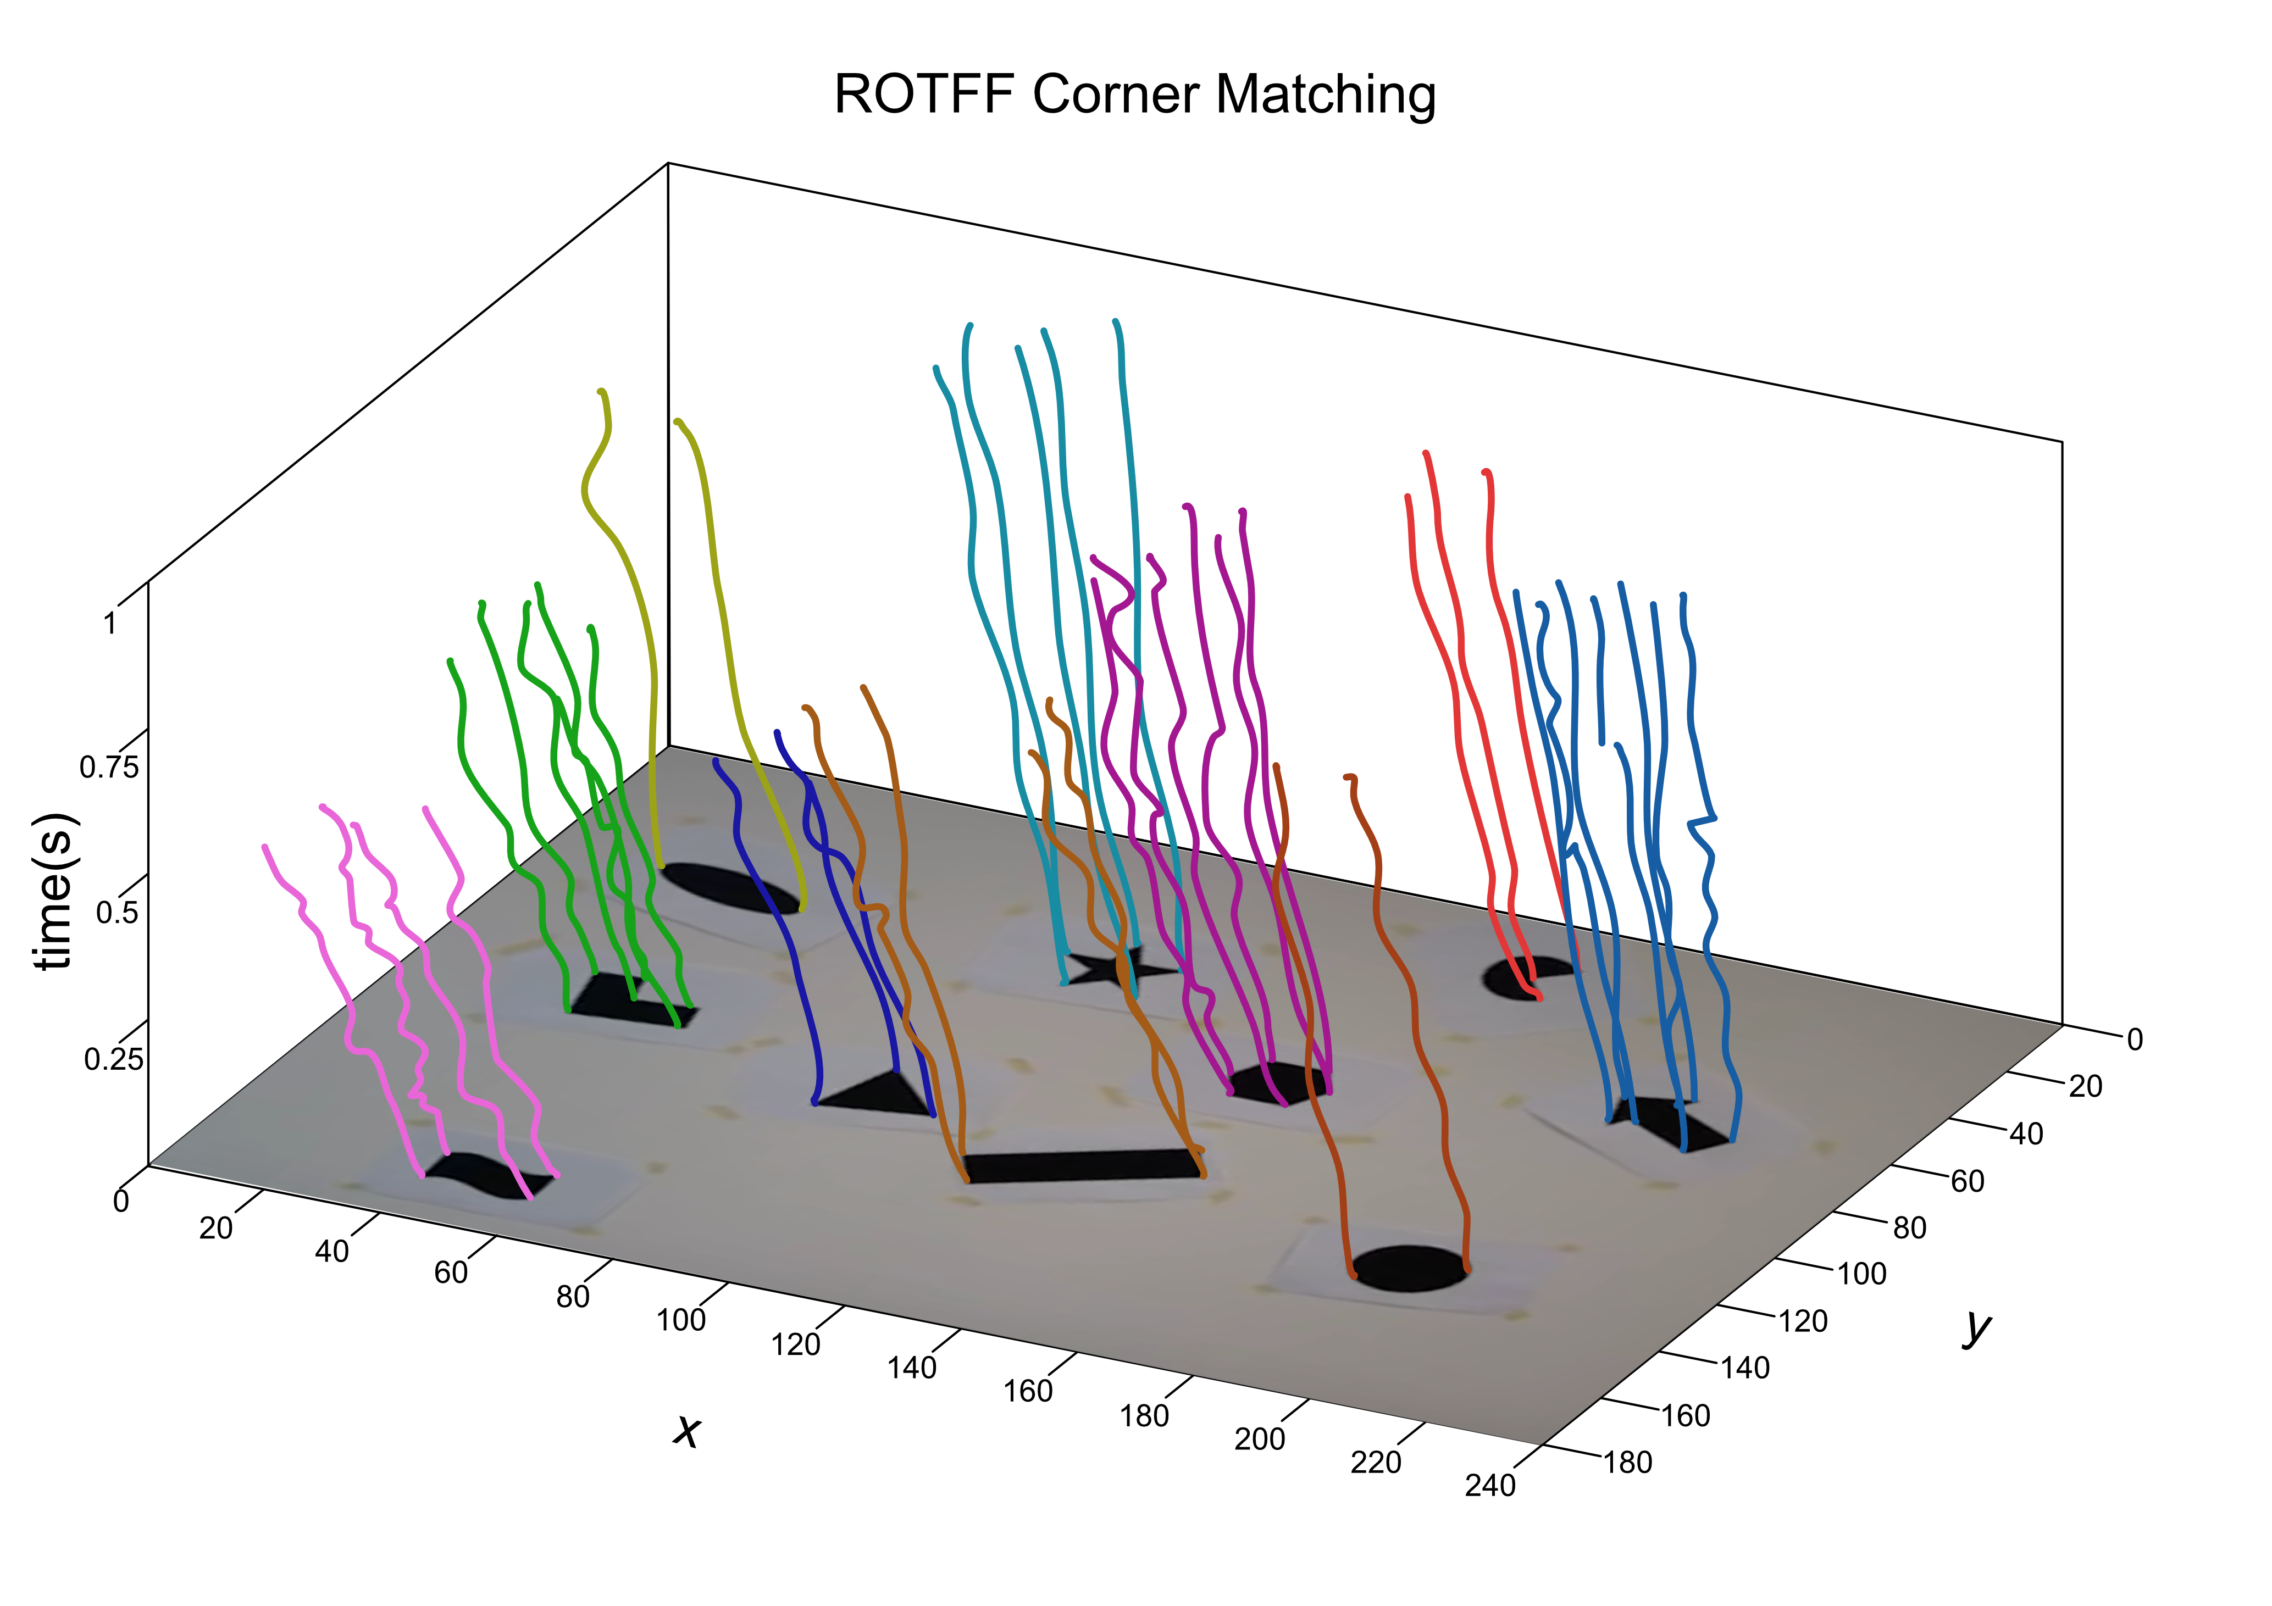
Our Research
Feature
Detection
Feature
Tracking

Slide 44

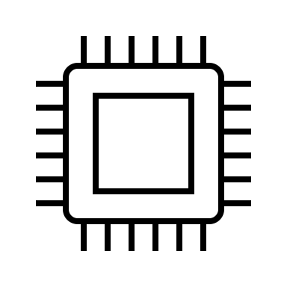
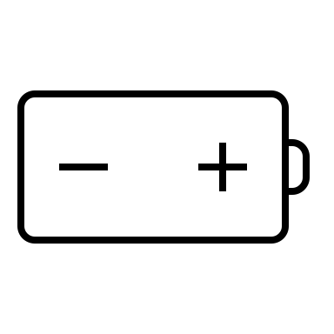


Summary
Neuromorphic vision is a growing area of research involving the processing of visual information obtained from asynchronous bio-inspired sensors.
These sensors offer high-speeds, low-latency and sparse data outputs compared to convention methods.
At Ulster our research is focused on processing both at the low-level and high-level application domains.

Slide 45
Introduction
Neuromorphic Vision
Neuromorphic Data Processing
Questions

